Slide 1

Utilizing Kafka Events in the Frontend

Slide 2

What is Kafka?
Kafka is a distributed event streaming platform.
Used to publish, subscribe, store, and process real-time event data.
Backend services use it to broadcast domain events.

Slide 3

Why Use Kafka in the Frontend?
Real-time updates without polling.
React instantly to backend changes.
Great for dashboards, bookings, notifications, etc.

Slide 4
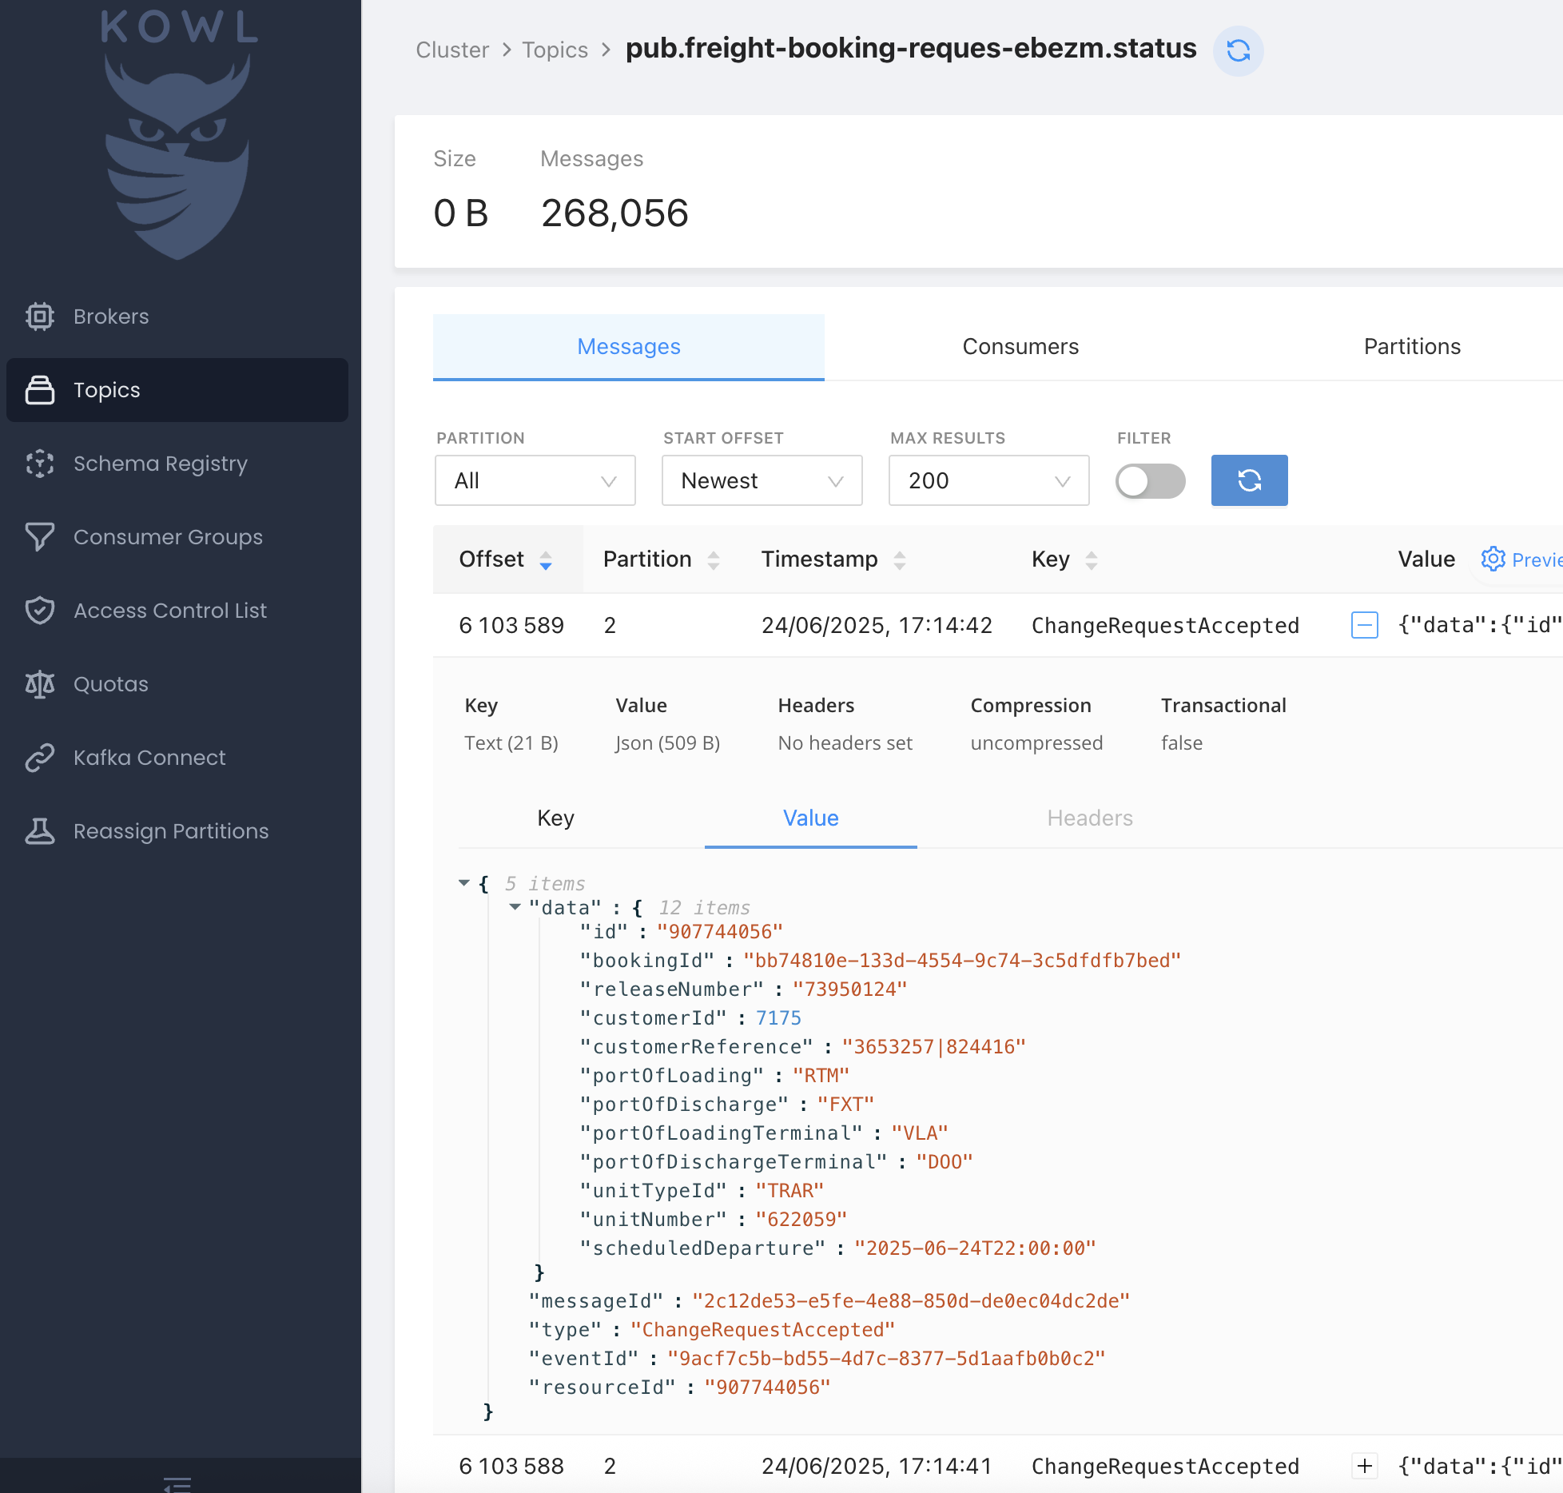
Explore Kafka Topics
Tool: Kowl
Run locally via Docker:
docker run -p 8080:8080 \
-e KAFKA_BROKERS=<KAFKA_BOOTSTRAP_SERVER> \
-e KAFKA_TLS_ENABLED=true \
-e KAFKA_SASL_ENABLED=true \
-e KAFKA_SASL_USERNAME=<KAFKA_USERNAME> \
-e KAFKA_SASL_PASSWORD=<KAFKA_PASSWORD> \
quay.io/cloudhut/kowl:master

Slide 5
System Overview (Bird’s Eye View)
Backend publishes Kafka events
Node.js server subscribes via KafkaJS
Filters events per customerId
Sends to frontend via Socket.IO
React app listens and updates UI

Slide 6
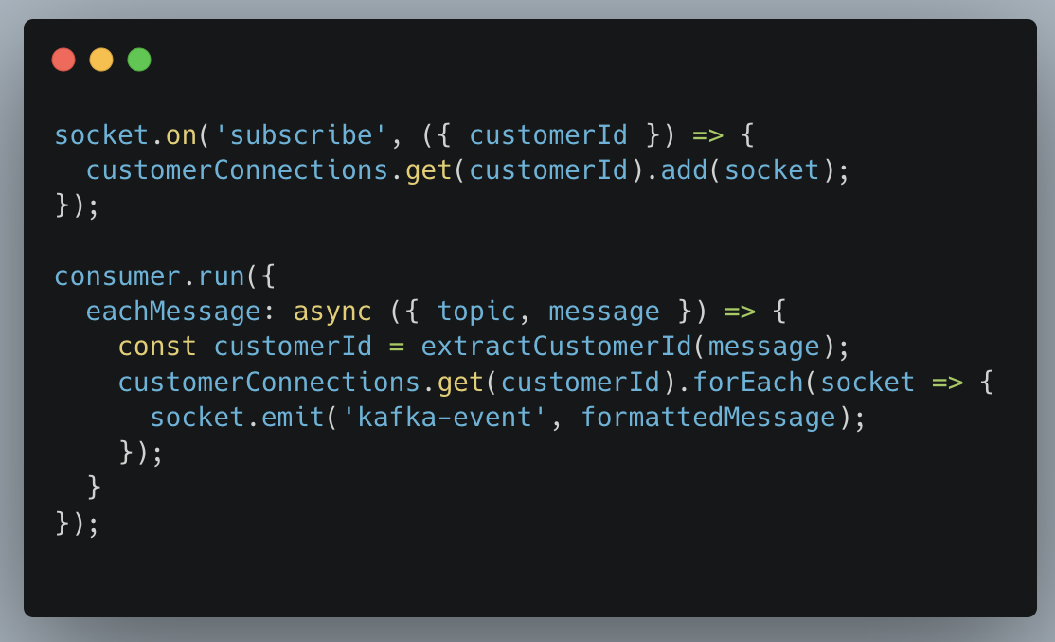
How the Backend Works
Express + KafkaJS + Socket.IO server
Subscribes to topics like `booking`, `status`
Parses messages and extracts `customerId`
Keeps a map of active Socket.IO connections
Only emits event to sockets subscribed to that `customerId`

Slide 7
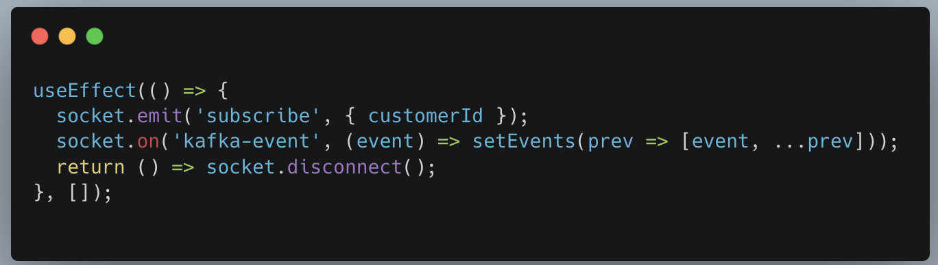
How the Frontend Works
React client connects via Socket.IO
User enters a `customerId` and clicks Connect
Subscribes with: `socket.emit('subscribe', { customerId })`
Listens for `kafka-event` and updates UI

Slide 8

Security Disclaimer
Add proper auth checks on: - Who can subscribe - What customer data they see
Token-based validation recommended

Slide 9

Summary
Kafka lets backend talk to frontend in real-time
Use Kowl to explore existing events
Node.js server as relay layer
React + Socket.IO for seamless UI updates

